Slide 1
C Language - Part 4
File Handling
Garimendra Verma (aka Gary), Presenter

Slide 2
Why files are needed?
When a program is terminated, the entire data is lost. Storing in a file will preserve your data even if the program terminates.
If you have to enter a large number of data, it will take a lot of time to enter them all. However, if you have a file containing all the data, you can easily access the contents of the file using a few commands in C.
You can easily move your data from one computer to another without any changes.

Slide 3
Types of Files
1. Text files
Text files are the normal .txt files. You can easily create text files using any simple text editors such as Notepad.
When you open those files, you'll see all the contents within the file as plain text. You can easily edit or delete the contents.
They take minimum effort to maintain, are easily readable, and provide the least security and takes bigger storage space.

Slide 4
Types of Files
2. Binary files
Binary files are mostly the .bin files in your computer.
Instead of storing data in plain text, they store it in the binary form (0's and 1's).
They can hold a higher amount of data, are not readable easily, and provides better security than text files.

Slide 5
File Operations
In C, you can perform four major operations on files, either text or binary:
Creating a new file
Opening an existing file
Closing a file
Reading from and writing information to a file

Slide 6
Working with files
When working with files, you need to declare a pointer of type file. This declaration is needed for communication between the file and the program.
FILE *fptr;

Slide 7
Opening a file - for creation and edit
Opening a file is performed using the fopen() function defined in the stdio.h header file.
The syntax for opening a file in standard I/O is:
ptr = fopen("fileopen","mode");
For example,
fopen("E:\\cprogram\\newprogram.txt","w");
fopen("E:\\cprogram\\oldprogram.bin","rb");
Notes:
Let's suppose the file newprogram.txt doesn't exist in the location E:\cprogram. The first function creates a new file named newprogram.txt and opens it for writing as per the mode 'w'.The writing mode allows you to create and edit (overwrite) the contents of the file.
Now let's suppose the second binary file oldprogram.bin exists in the location E:\cprogram. The second function opens the existing file for reading in binary mode 'rb'.The reading mode only allows you to read the file, you cannot write into the file.

Slide 8
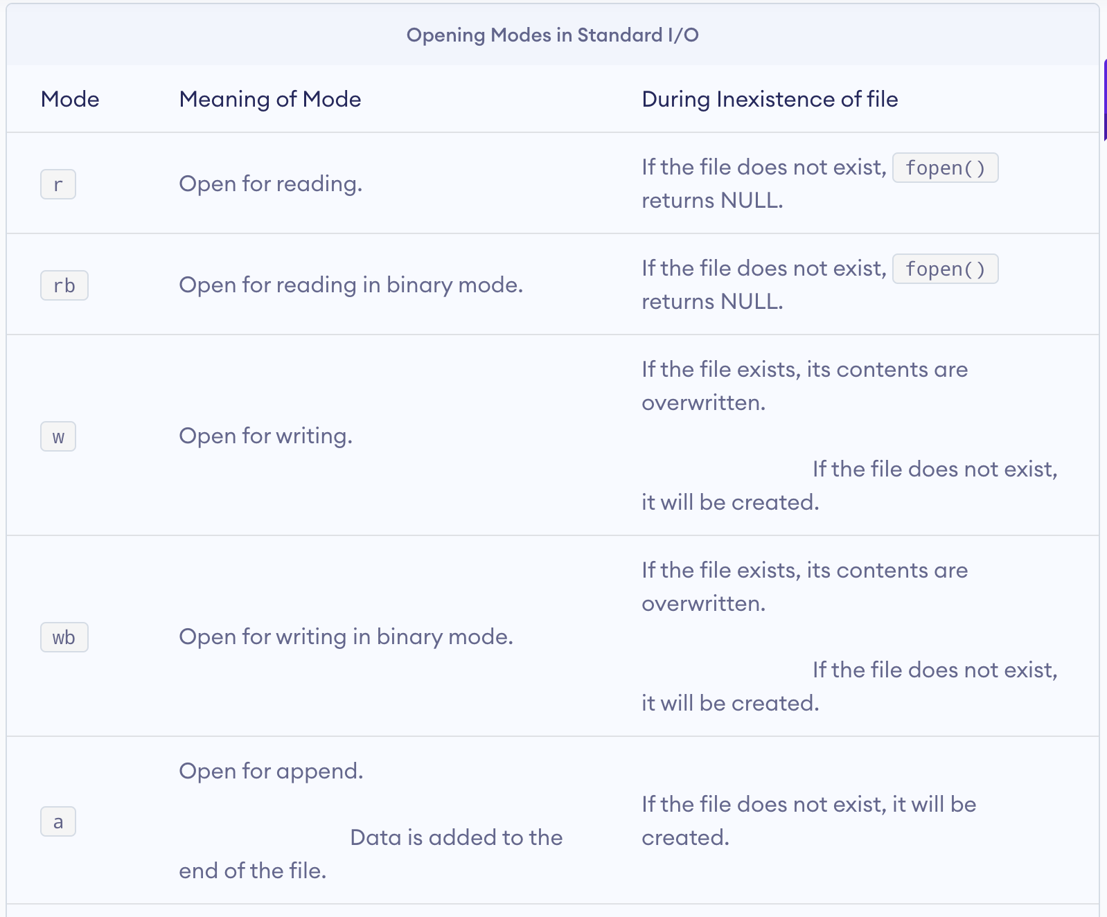
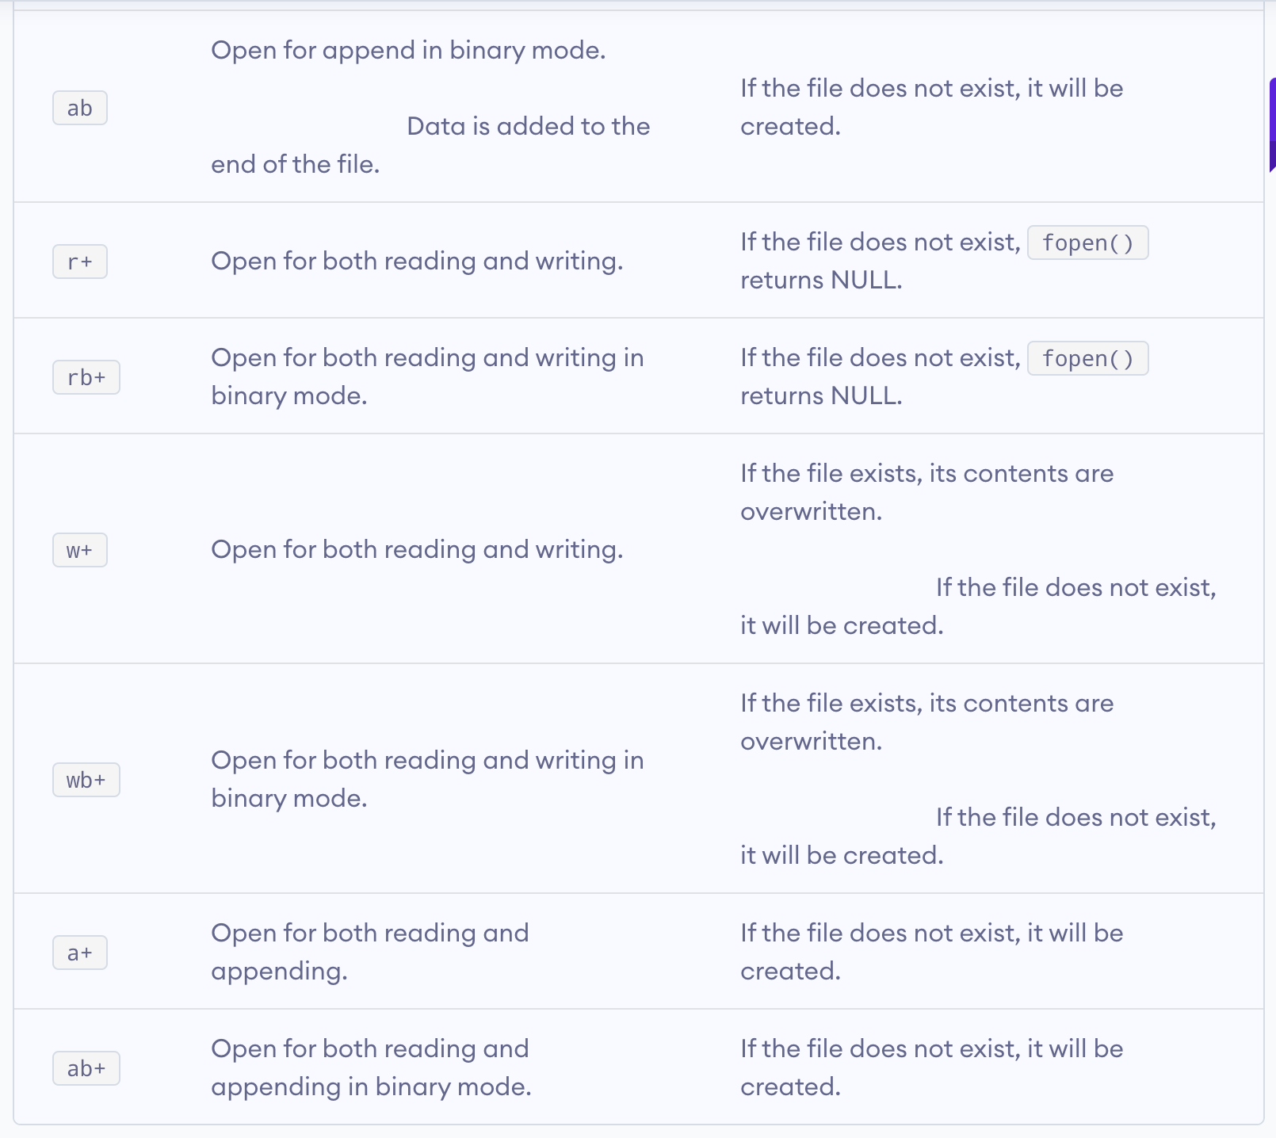

Slide 9
Closing a File
The file (both text and binary) should be closed after reading/writing.
Closing a file is performed using the fclose() function.
fclose(fptr);
Here, fptr is a file pointer associated with the file to be closed.

Slide 10
Reading and writing to a text file
For reading and writing to a text file, we use the functions fprintf() and fscanf().
They are just the file versions of printf() and scanf(). The only difference is that fprint() and fscanf() expects a pointer to the structure FILE.

Slide 11
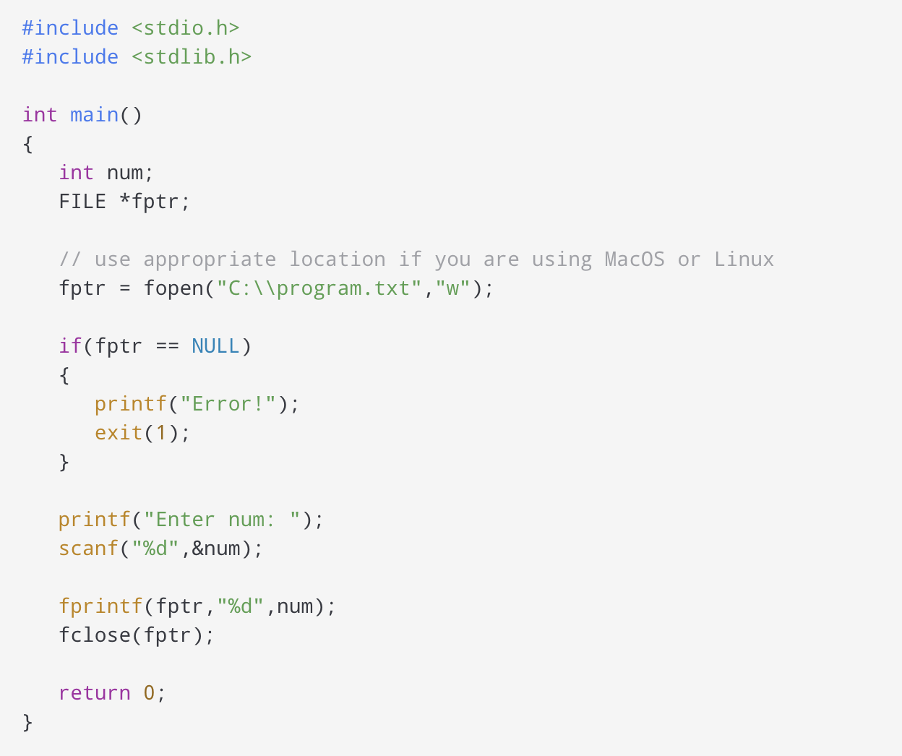
Example 1: Write to a text file
Notes:
This program takes a number from the user and stores in the file program.txt.
After you compile and run this program, you can see a text file program.txt created in C drive of your computer. When you open the file, you can see the integer you entered.

Slide 12
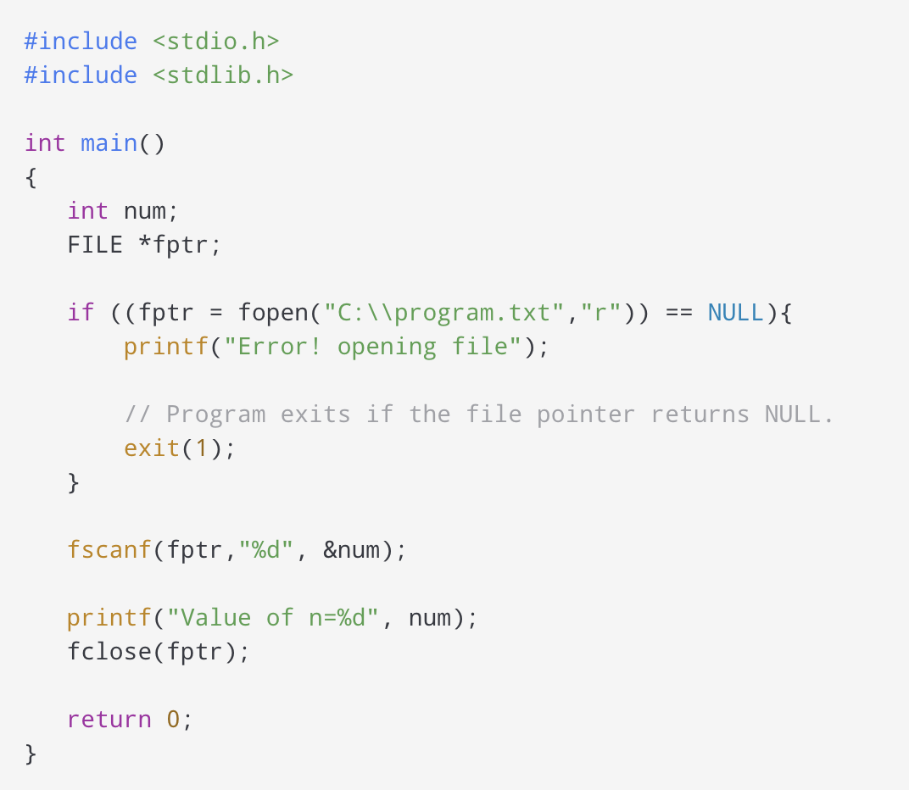
Example 2: Read from a text file
Notes:
This program reads the integer present in the program.txt file and prints it onto the screen.
If you successfully created the file from Example 1, running this program will get you the integer you entered.
Other functions like fgetchar(), fputc() etc. can be used in a similar way.

Slide 13
Reading and writing to a binary file
Functions fread() and fwrite() are used for reading from and writing to a file on the disk respectively in case of binary files.

Slide 14
Writing to a binary file
To write into a binary file, you need to use the fwrite() function. The functions take four arguments:
address of data to be written in the disk
size of data to be written in the disk
number of such type of data
pointer to the file where you want to write. fwrite(addressData, sizeData, numbersData, pointerToFile);

Slide 15
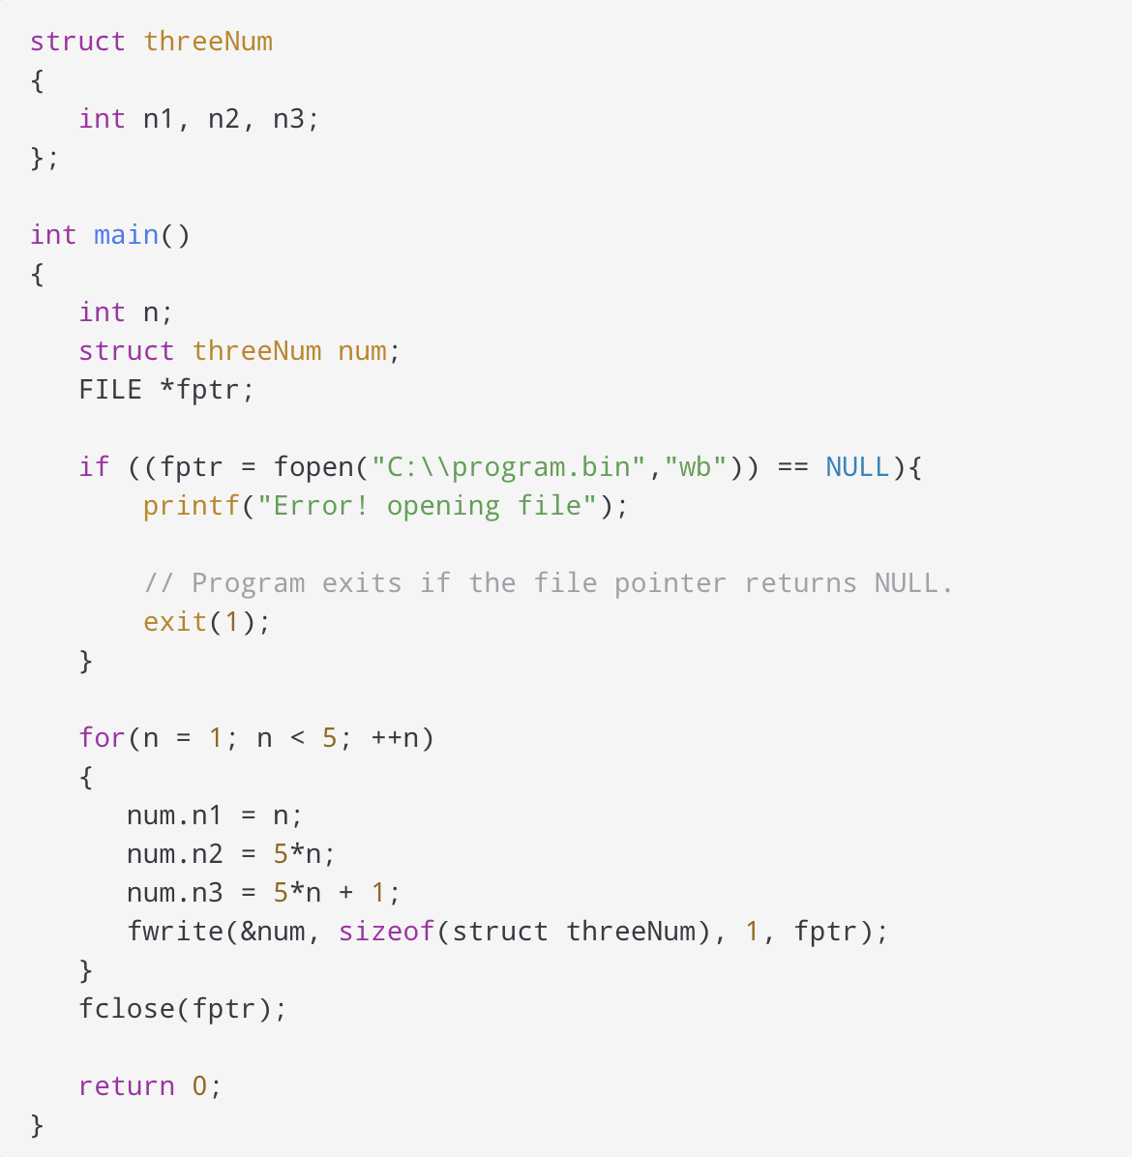
Example 3: Write to a binary file using fwrite()
Notes:
In this program, we create a new file program.bin in the C drive.We declare a structure threeNum with three numbers - n1, n2 and n3, and define it in the main function as num. Now, inside the for loop, we store the value into the file using fwrite().The first parameter takes the address of num and the second parameter takes the size of the structure threeNum. Since we're only inserting one instance of num, the third parameter is 1. And, the last parameter *fptr points to the file we're storing the data. Finally, we close the file.

Slide 16
Reading from a binary file
Function fread() also take 4 arguments similar to the fwrite() function as above.
fread(addressData, sizeData, numbersData, pointerToFile);

Slide 17
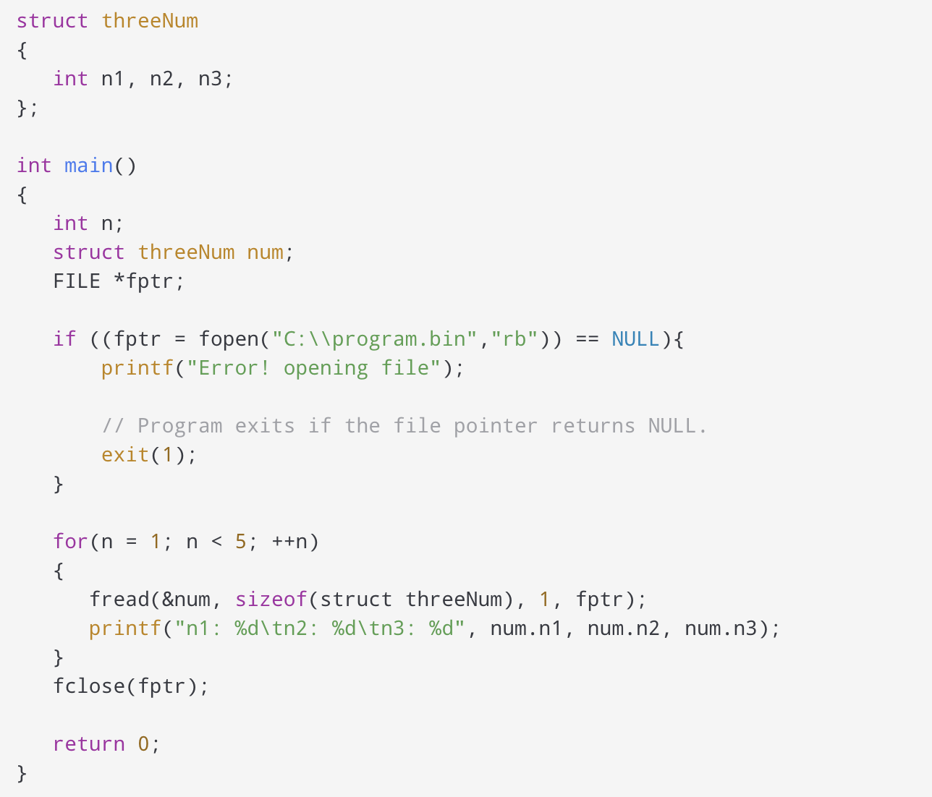
Example 4: Read from a binary file using fread()
Notes:
In this program, you read the same file program.bin and loop through the records one by one.
In simple terms, you read one threeNum record of threeNum size from the file pointed by *fptr into the structure num.
You'll get the same records you inserted in Example 3.

Slide 18
Getting data using fseek()
If you have many records inside a file and need to access a record at a specific position, you need to loop through all the records before it to get the record.
This will waste a lot of memory and operation time. An easier way to get to the required data can be achieved using fseek().
As the name suggests, fseek() seeks the cursor to the given record in the file.

Slide 19
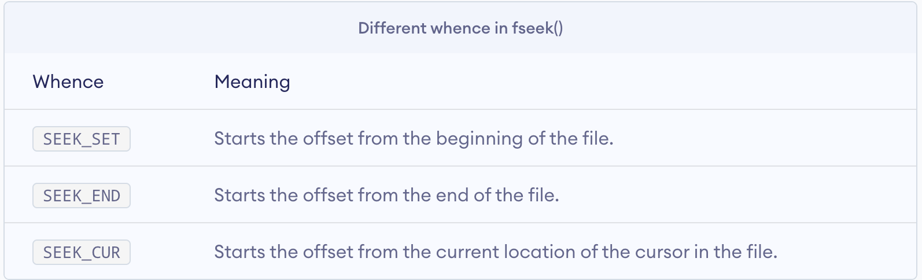
Syntax of fseek()
fseek(FILE * stream, long int offset, int whence); The first parameter stream is the pointer to the file. The second parameter is the position of the record to be found, and the third parameter specifies the location where the offset starts.

Slide 20
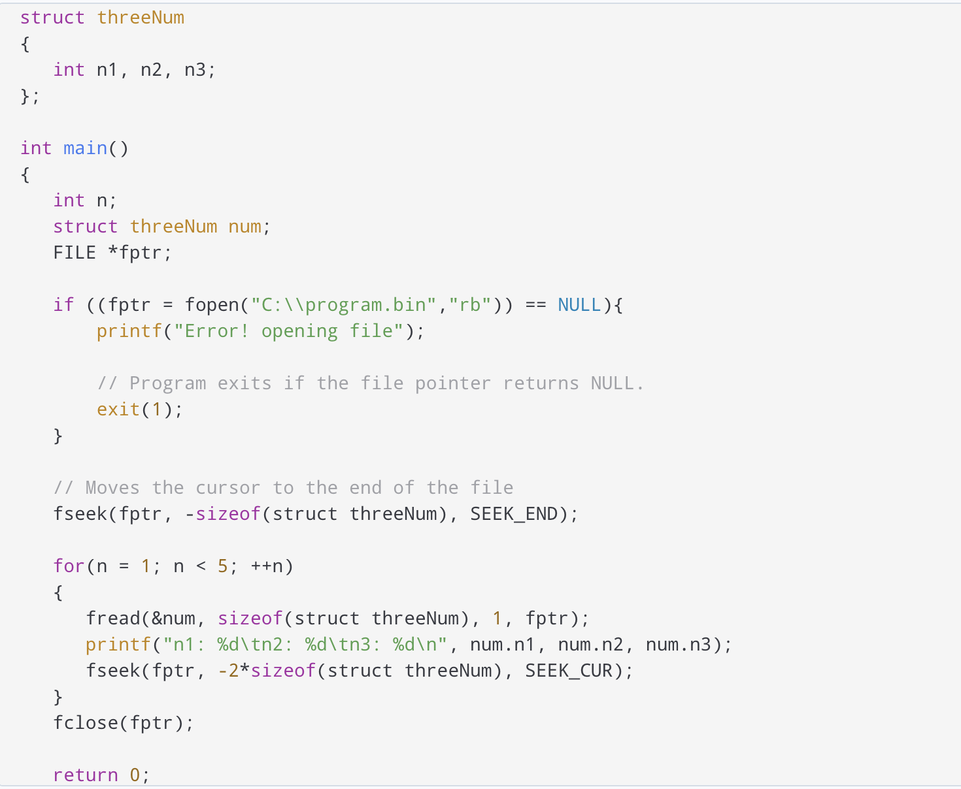
Example 5: fseek()
Notes:
This program will start reading the records from the file program.bin in the reverse order (last to first) and prints it.

Slide 21
Exercise Time!
1. C program to read name and marks of n number of students and store them in a file.
2. C program to read name and marks of n number of students from and store them in a file. If the file previously exits, add the information to the file.
3. C program to write all the members of an array of structures to a file using fwrite(). Read the array from the file and display on the screen.

Slide 22
Thank You!

